Slide 1
POWER UP!
1:1 information

Slide 2
OVERVIEW
Richmond County School System is “to provide an equitable education for all students to prepare them for life beyond the classroom.” Computer literacy is an important part of today's world - all students need the opportunity to learn to use programs commonly used in the workforce and colleges. The PowerUp initiative uses our education sales tax funds to provide a device for every student.
These devices will help assignments to be personalized, engaging, and can increase creativity. This initiative can also provide access to knowledge outside of the classroom. The PowerUp Handbook is designed to help our students understand how to care for the device, use it properly, find help if needed, and to become good digital citizens.
PowerUp is a school based initiative. Parent orientation and device distribution information will be shared from the school. Stay tuned and get ready to PowerUp!

Slide 3
Course for parents
The PowerUp Course for Parents is designed to provide information about our technology initiative and teach you how to navigate in our online classroom platform that we call Canvas. The PowerUp course is designed just like an online course that your child would take, minus graded assignments. So, you can receive credit for completing the course, please complete the form at the end.
Copy and paste this URL into your web browser https://rcboe.instructure.com/courses/141215

Slide 4
Device cost and insurance
Damage = $25 for Laptop; $50 for iPad (cracked screen, jammed keys, etc.)
Lost or Stolen = replacement cost unless optional insurance was purchased.
Charging Cable replacement = $49
Optional Insurance: Available annually Cost for laptop insurance = $15.99 Cost for iPad insurance = $8.64 Cost for Chromebook insurance = $8.82
Insurance covers theft/burglary/robbery, fire, power surge, vandalism, and natural disasters, but does not cover damage (see device fees for damage costs). If a second device is damaged, lost, or stolen, the student will become a day-user.

Slide 5
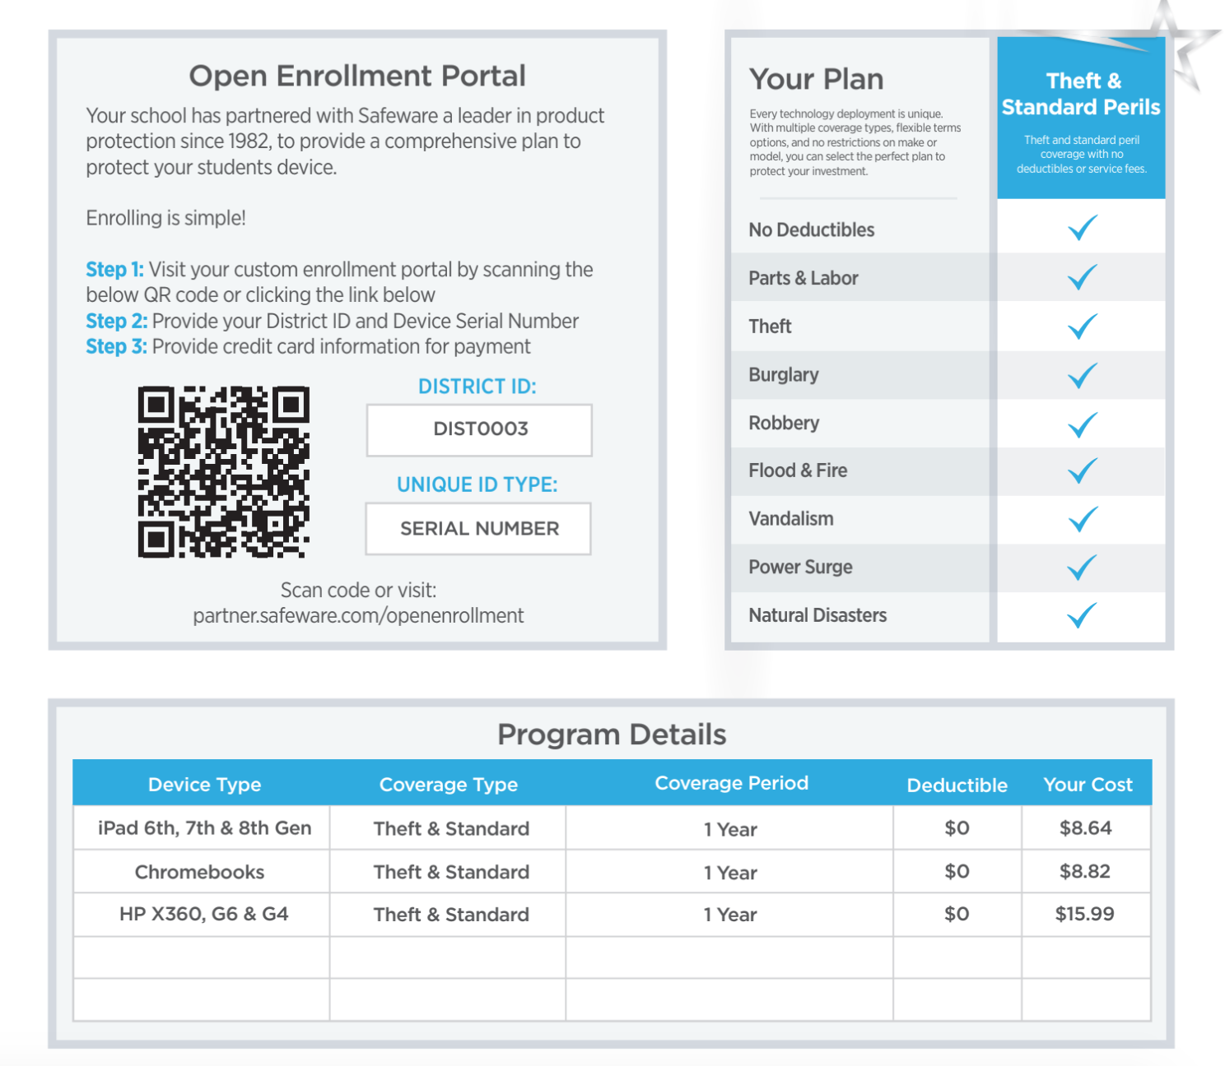
Insurance Enrollment

Slide 6
Technical support assistance
Students: If you have login issues or technology needs, please contact your school.
IT Helpline (706) 826-1103 or by email at ithelpdesk@boe.richmond.k12.ga.us (IT Support Services)
Launchpad: https://launchpad.classlink.com/rcboe
• When logging into Launchpad from home, students use the same computer login. (Ex: last name + first name + middle initial)
• Launchpad is a safe, secure way for students to connect with applications and files. The software does not collect or share any personal student information, which is important to us. Best of all, it is very easy to use and will be a great resource for teachers and students.

Slide 7
Technology loan agreement
All use of the school system’s laptops/tablets must be for educational purposes and students are not to use the device for personal, commercial, or business use.
Students are accountable for and assume full responsibility for the care of my device.
Students assume full responsibility for the security of the device on and off school premises.
Students assume full responsibility for reporting device problems, breakage, or damage immediately.
The use of a county-issued device is a privilege. Students will be offered an optional insurance plan to cover the replacement cost of the device should it be damaged, lost, or stolen. This plan will cover one device per year. If the student loses or damages the second device, the student will become a “day-user” and will be provided a device at school, but cannot take a device off-campus.

Slide 8
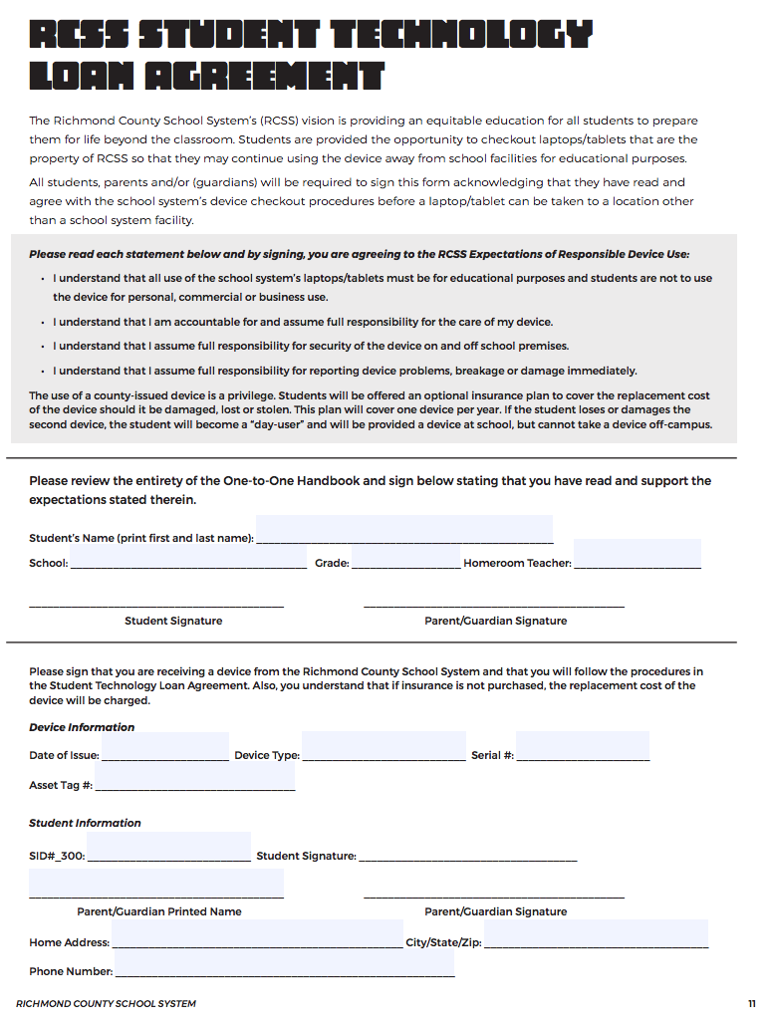
Copy of loan agreement

Slide 9
Thanks!

